Slide 1
Introduction to Data Science
Jay Urbain, PhD

Slide 2
Topics
Course introduction
Data Deluge
What is data science?
Data science skills
Role of data scientist
Need for data science
Why become a data scientist
eScience
Application examples

Slide 3
Introduction to Data Science
This course provides an introduction to applied data science including data preparation, exploratory data analysis, statistical inference, predictive modeling, factor analysis, and data visualization.
Review:
Course description
Course outcomes
Grading policy (syllabus)
Course structure:
Lectures
~weekly hands-on lab assignments using Jupyter notebooks + final 2-week project
Quizzes as needed
Midterm, final
Brand new course!
May adjust topics and assignments
Appreciate any and all forms of feedback

Slide 4
Data Deluge
The availability and cost of collecting and storing data has plunged.
Businesses, governments, and society are trying to tap its vast potential, gain competitive advantage.

Slide 5
How much data do we create?
There are 2.5 quintillion bytes (10¹⁸) of data created each day at our current pace*.
Pace is only accelerating with the growth of the Internet of Things (IoT).
Over the last two years alone 90 percent of the data in the world was generated.
Every time we interact with the Internet, we generate data.
Google search
Text messages
32 billion people are active on Facebook daily
Continuous location update
Pictures
???
*Forbes, May 21, 2018. https://www.forbes.com/sites/bernardmarr/2018/05/21/how-much-data-do-we-create-every-day-the-mind-blowing-stats-everyone-should-read/#2959a86f60ba

Slide 6
How much data do we create?
https://www.domo.com/learn/data-never-sleeps-5?aid=ogsm072517_1&sf100871281=1

Slide 7
What is Data Science?
“The ability to take data—to be able to understand it, to process it, to extract value from it, to visualize it, to communicate it—that’s going to be a hugely important skill.”
“The next sexy job”
Hal Varian, Google’s Chief Economist, NYT, 2009:
“They need to find nuggets of truth in data and then explain it to the business leaders”
Richard Snee, EMC
“Data Science refers to an emerging area of work concerned with the collection, preparation, analysis, visualization, management and preservation of large collections of information.”
Jeffrey Stanton, Syracuse University
Extract insights from messy data
Joel Grus
Extract actionable knowledge from data.
Jay Urbain, MSOE ;-)

Slide 8
Data Science Skills
Data Munging - parsing, scraping, formatting, querying data
Statistics - traditional analysis
Machine learning – modeling, prediction
Communication + Visualization – reports, tables, graphs, etc.
Scientific method common –
Scientific discovery and building knowledge
Requires motivating questions about the world and hypotheses that can be brought to data and tested statistically.
search for answers, prove/disprove hypothesis from data.

Slide 9
Data Science Venn Diagram
Drew Conway, 2013.

Slide 10
Role of Data Scientist
Data scientists assigned to point projects
Here’s a question. Is there a “signal” in the data to help us answer that question.
Need to integrate data sources
ETL pipeline is too heavy weight.
Do predictive modeling from signal(s)
Monitor data streams to predict equipment failure.
Buy Google keywords – what keywords to buy?

Slide 11
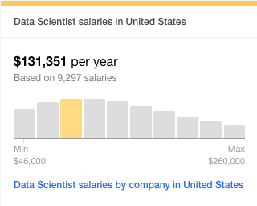
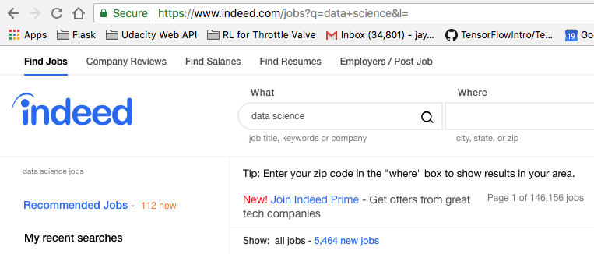
Why Data Science?
Knowledge discovery is fun
Opportunities

Slide 12
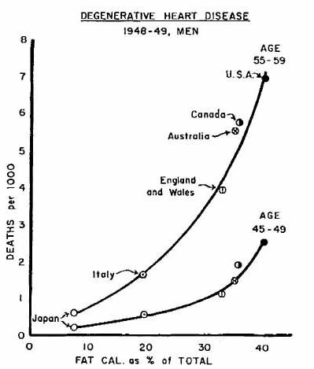
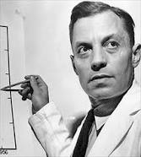
Data makes everything more clear
Seven Countries Study (Ancel Keys, UCB 1925,28)
13,000 subjects total, 5-40 years follow-up.

Slide 13
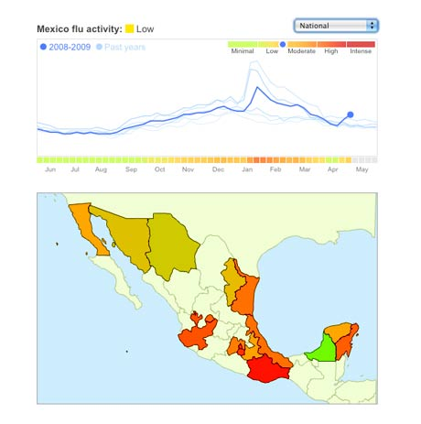
Data Science: Why all the Excitement?
e.g.,
Google Flu Trends:
Detecting outbreaks
two weeks ahead
of CDC data
Note: Did not hold. As more
people heard about Google
Flu Trends, more people searched.
New models are estimating which cities are most at risk for spread of the Ebola virus.

Slide 14
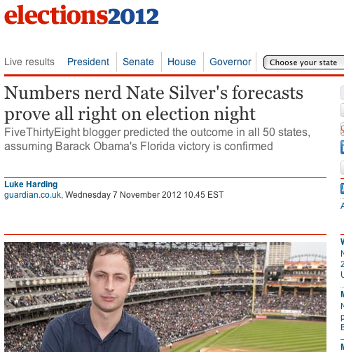
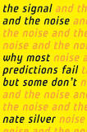
Why the all the Excitement?
Revolutionized politics. Silver did not do well for 2016 election, but others did.

Slide 15

A long time ago, science was only empirical
People counted things – stars, crop yield, ROI

Slide 16
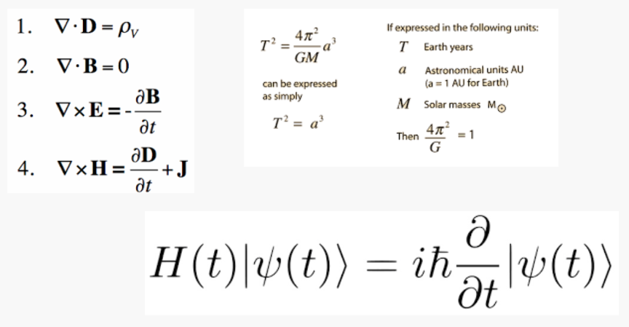
A few hundred years ago, scientists developed theoretical approaches.
Derive equations to describe phenomena

Slide 17
eScience = Data Science
Empirical
Theoretical
Computational
Computational methods of discovery

Slide 18
eScience is about the analysis of data
The automated or semi-automated extraction of knowledge from massive volumes of data.
Simply too much of it to look at.
Too complex to understand hidden relationships.
It’s not just a matter of volume. The Three V’s of Big Data:
Volume: number of rows / objects / bytes
Variety: number of columns / dimensions / sources
Velocity: number of rows / bytes per unit time
More V’s: - Veracity: Can we trust this data? ￼￼
Data analysis has replaced data acquisition as the new bottleneck to discovery.

Slide 19
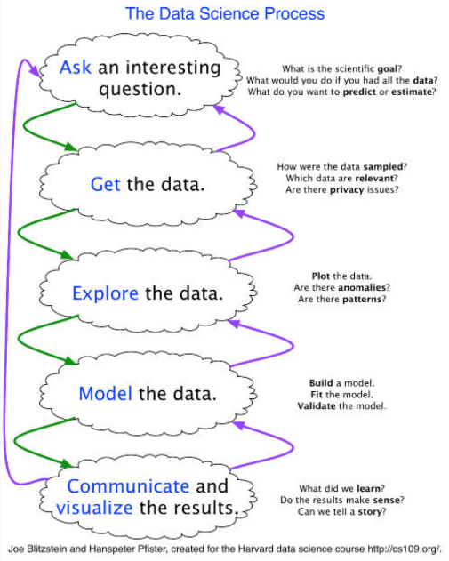
Computational approach
Knowledge discovery

Slide 20
Example 1: Medical Costs
MGH Cancer Center
Where do patient costs come from?
Is there some property for treating the most expensive patients?
Are they sicker?
Really no difference in degree of sickness.
So what are the factors that represents this cost factors?
Additional treatment that is not making the patients better.

Slide 21
Example: Disease Management
Paired indicators of Prostate Cancer
Given a patient with a history of a progressive disease, can we identify similar patients in earlier stages?
Can we treat patients prospectively and achieve better outcomes?

Slide 22
Example: Flight prediction/flight delays
Weather, congestion, flights delayed, mechanical failure.
Understanding why a flight is delayed: challenging.
Big Data problem – many types of information to integrate, and diverse data sets disagree.
People need help solving this integration and data veracity problem.

Slide 23
Example: Data analytics for transportation
Daniel Rus, MIT
Time in transportation has doubled or tripled in some cases
Data-driven transportation via data streams
Modeling, prediction, and controlling
Improve level of service
Enhance sustainability
Personalization
Optimization

Slide 24
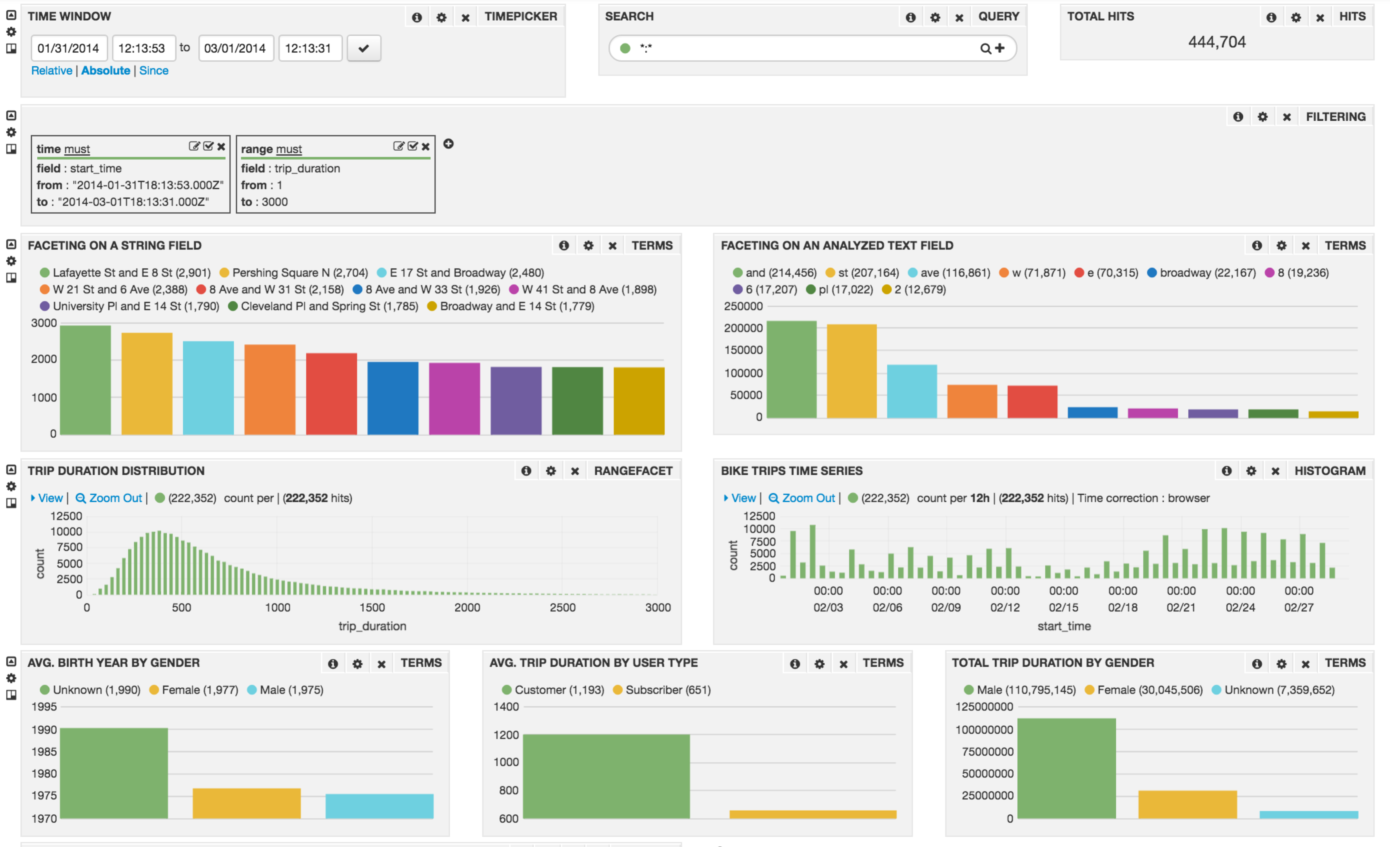
Example: Data analytics for bike sharing
Faceting by:
Time
Location
Date
Gender
Station
Duration

Slide 25
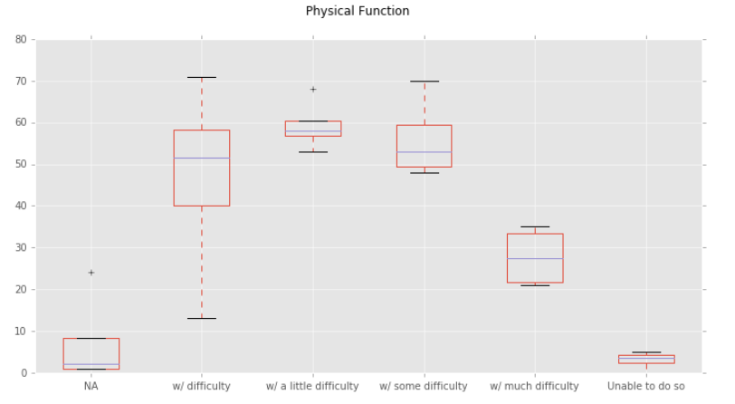
Example: Analyzing chronic back pain data

Slide 26
Example: Analyzing comorbid factors

Slide 27
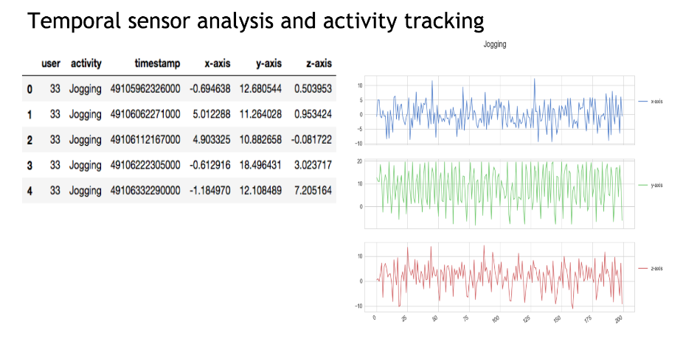
Example: Analyzing activity data

Slide 28
Example: And ultimately, the web graph
Web graph abstraction
Everything is interconnected

